Slide 1
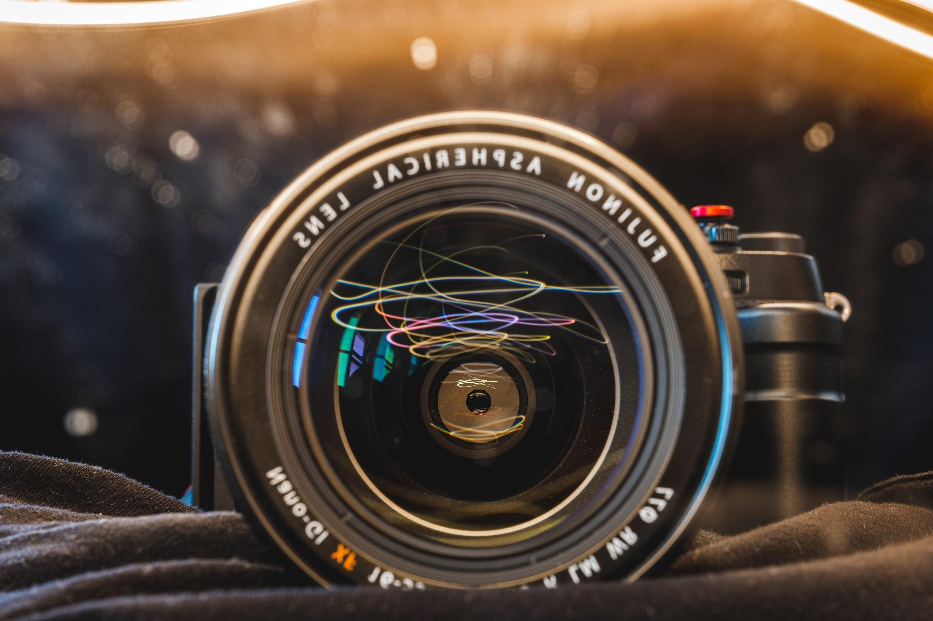
IMAGE ENHANCEMENT

Slide 2
Digital signal processing
Sem-Project
Presented by: (Group 12)
Neha Mahindrakar(18BEC032)
Nikhil SA(18BEC033)
Nithin Rangineni(18BEC034)

Slide 3
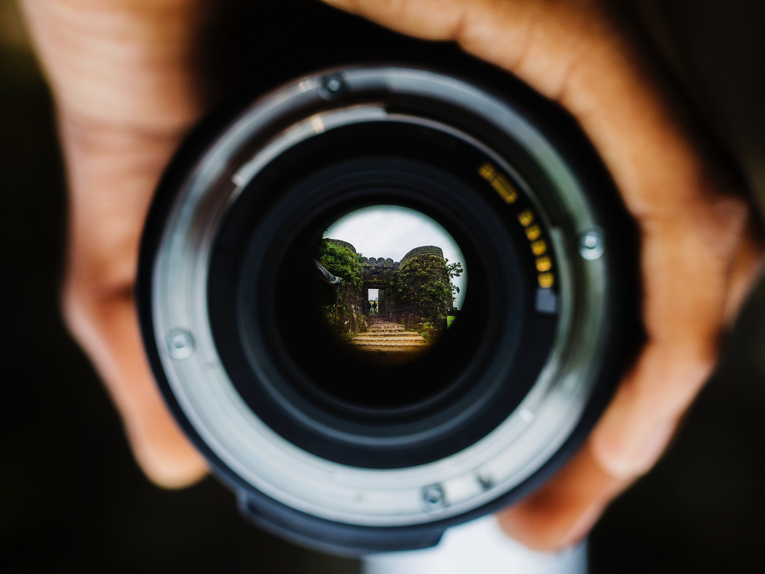
Image enhancement, one of the image pre-processing image is the procedure of improving the quality and information content of a digital image .
In other words improving noise, sharpening ,deblurring or brightening an image is its enhancement.

Slide 4
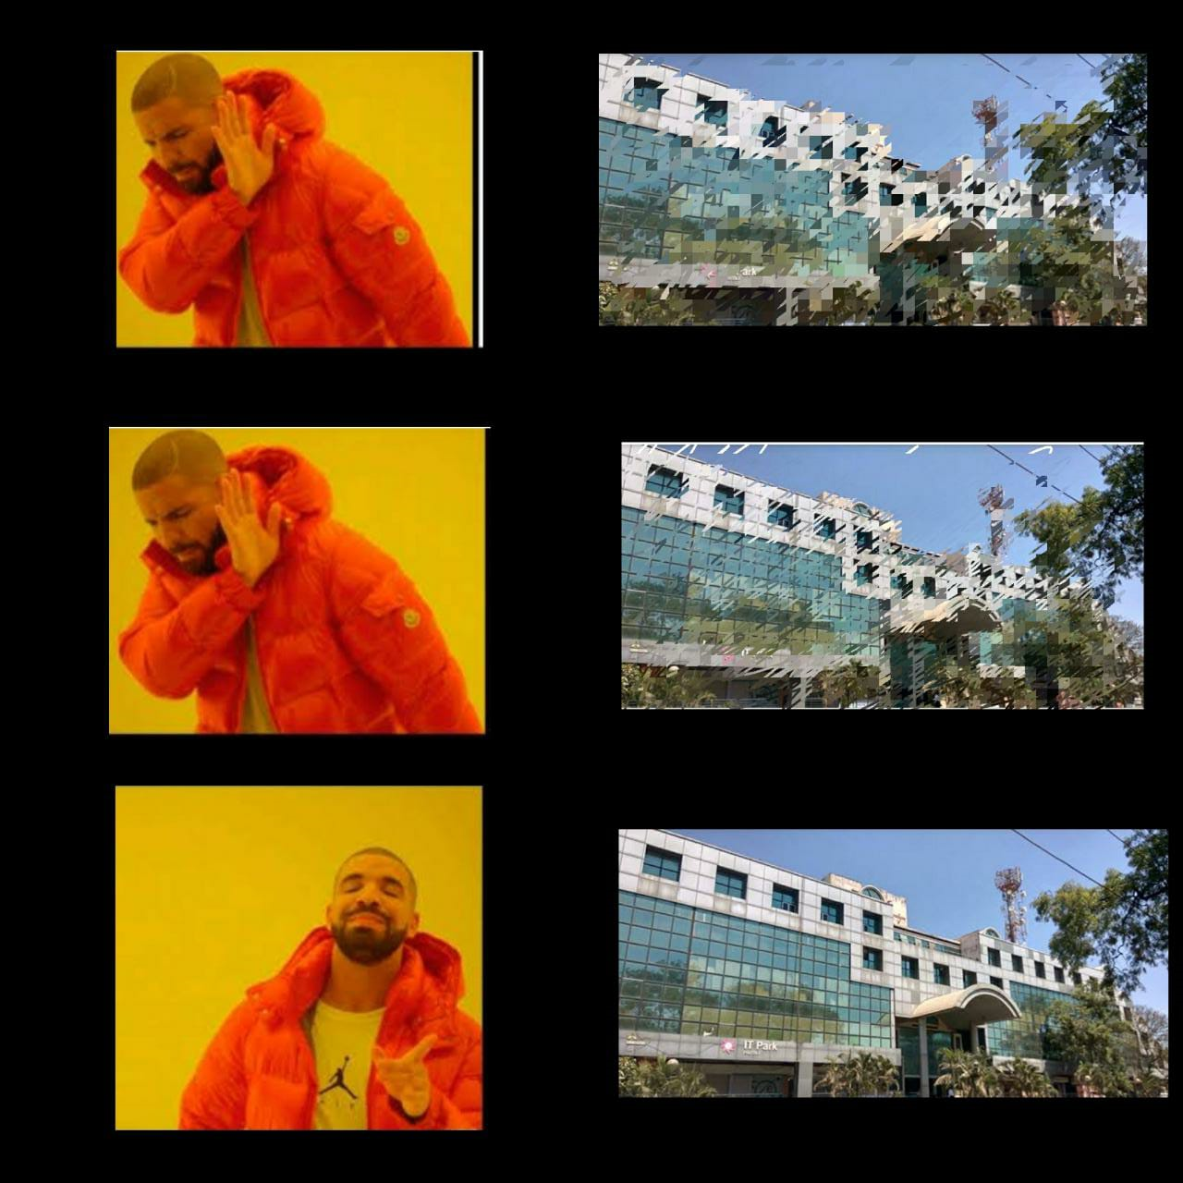
The aim of image enhancement is to improve the interpretability or perception of information in images for human viewers, or to provide ‘better’ input for other automated image processing techniques.
They are used in Aerial imaging, Satellite imaging, Medical imaging, Digital camera application , Remote sensing etc.

Slide 5
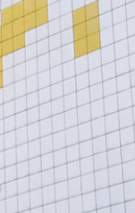
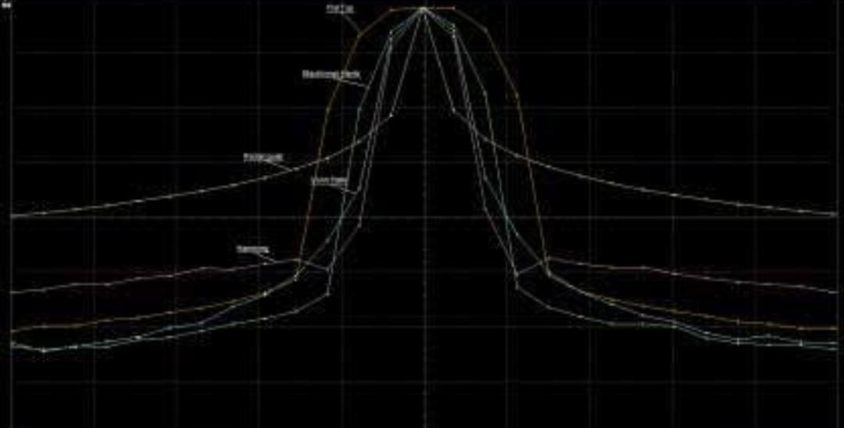
Image processing techniques are broadly classified into two major methods. They are:
FREQUENCY DOMAIN METHODS
We compute the fourier transform of the image to be enhanced, multiply the result by a filter and take the inverse transform to produce the enhanced image.
SPATIAL DOMAIN METHODS
Includes direct manipulation on pixels of an image. The two main approaches include
1.Point processing
2.Neighbourhood Operations
.

Slide 6
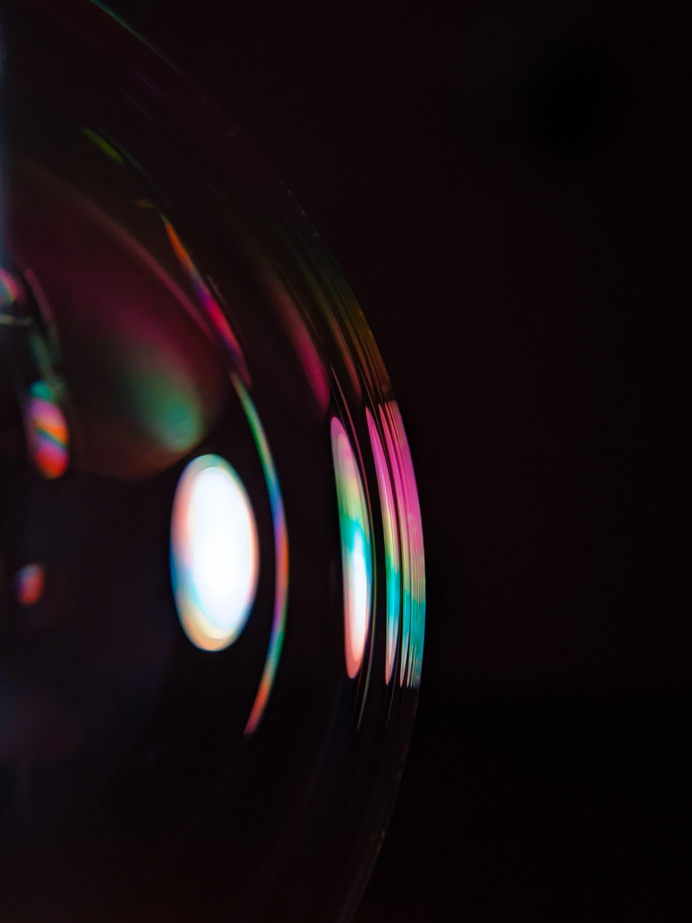
1.Histogram Processing:
Histogram Equalization (HE)
This includes Spatial domain methods taking into account a histogram of an overall / part of an pixels of an image, processing is done.
Exact Histogram Specification (EHS)
Layered Difference Representation(LDR)
Histogram Modification Framework(HMF)
Contextual and Variational Enhancement(CVC)

Slide 7
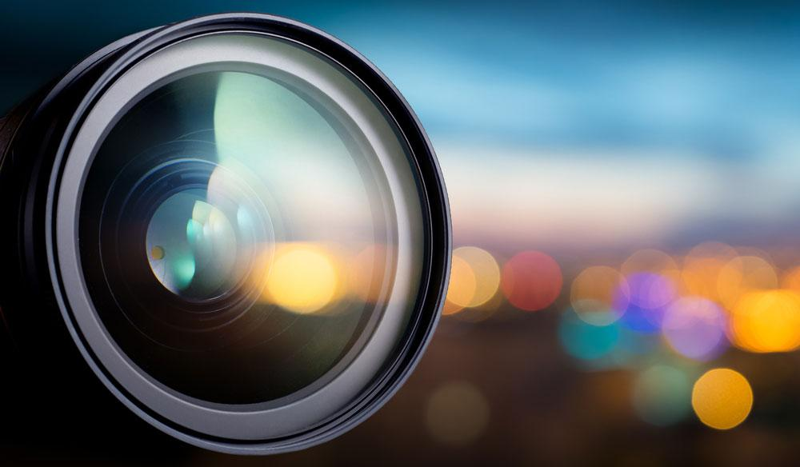
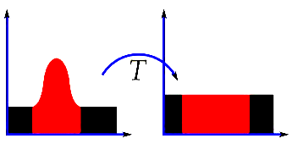
Histogram Equalization:
Histogram Equalization is an image processing technique that adjusts the contrast of an image by using its histogram. To enhance the image’s contrast, it spreads out the most frequent pixel intensity values or stretches out the intensity range of the image. By accomplishing this, histogram equalization allows the image’s areas with lower contrast to gain a higher contrast.

Slide 8
Why do we need Histogram equalization?
Histogram Equalization can be used when you have images that look washed out because they do not have sufficient contrast. In such photographs, the light and dark areas blend together creating a flatter image that lacks highlights and shadows.

Slide 9
Code:
import cv2 as cv
import numpy as np
from matplotlib import pyplot as plt
path = "______"
img = cv.imread(path)
cv.imshow('image',img)
hist,bins = np.histogram(img.flatten(),256,[0,256])
cdf = hist.cumsum()

Slide 10
cdf_normalized = cdf * float(hist.max()) / cdf.max()
plt.plot(cdf_normalized, color = 'b')
plt.hist(img.flatten(),256,[0,256], color = 'r')
plt.xlim([0,256])
plt.legend(('cdf','histogram'), loc = 'upper left')
plt.show()
R, G, B = cv.split(img)
output1_R = cv.equalizeHist(R)
output1_G = cv.equalizeHist(G)
output1_B = cv.equalizeHist(B)
equ = cv.merge((output1_R, output1_G, output1_B))
cv.imshow('equ.png',equ)
hist,bins = np.histogram(equ.flatten(),256,[0,256])
cdf = hist.cumsum()
cdf_normalized = cdf * float(hist.max()) / cdf.max()

Slide 11
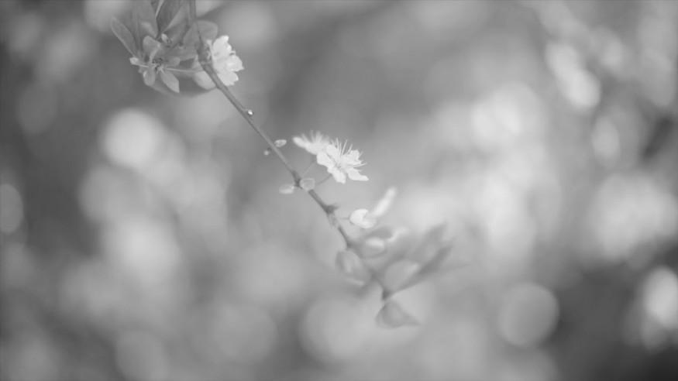
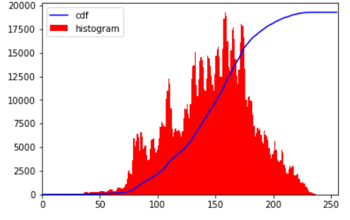
plt.plot(cdf_normalized, color = 'b')
plt.hist(equ.flatten(),256,[0,256], color = 'r')
plt.xlim([0,256])
plt.legend(('cdf','histogram'), loc = 'upper left')
plt.show()
Input Image Histogram

Slide 12
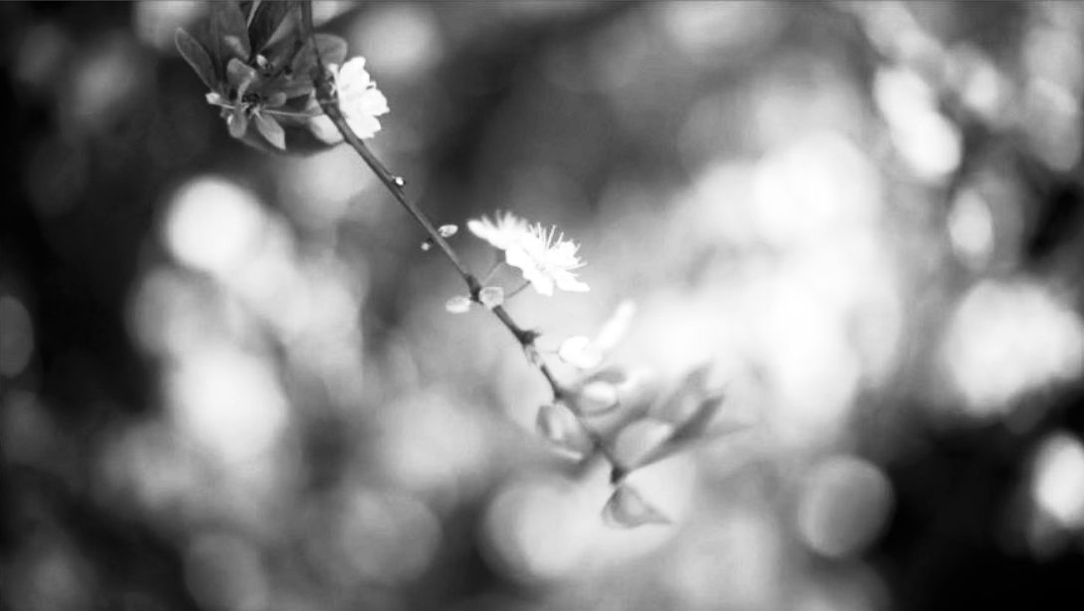
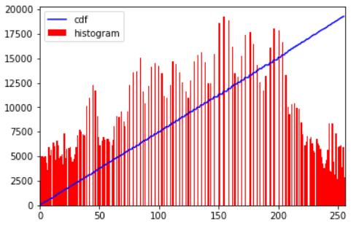
Histogram of a enhanced image
Thank you
Output Image

